Slide 1
Lecture 4
Recap
Adversarial Robustness in QML: A Light weight introduction

Slide 2
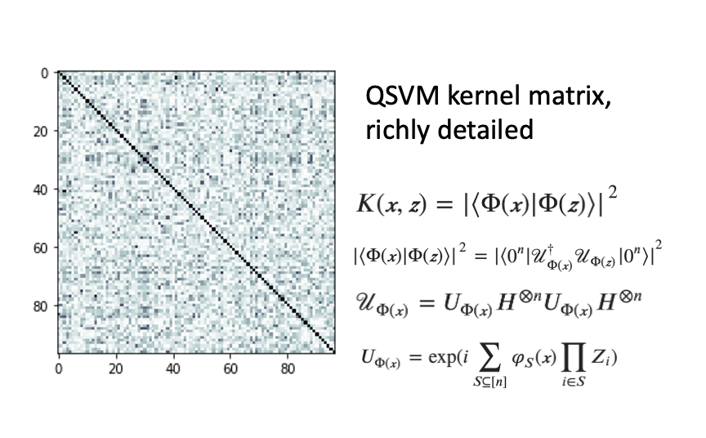
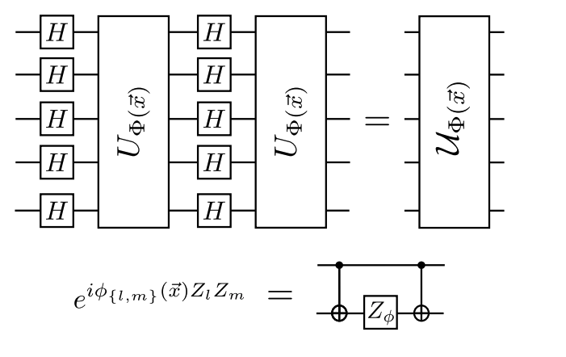
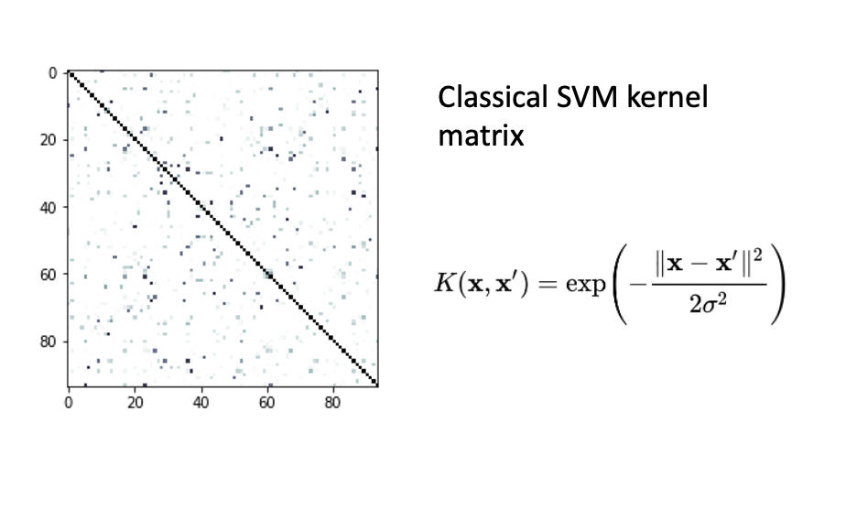
Recap: Quantum classification with QSVM

Slide 3
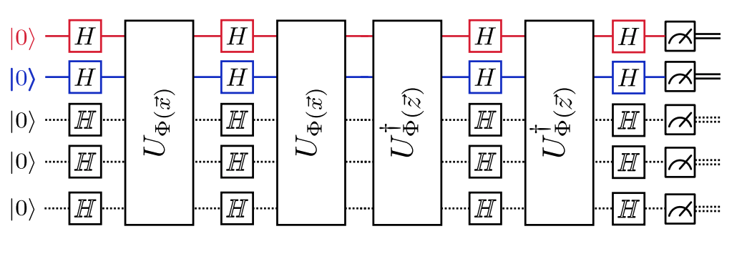
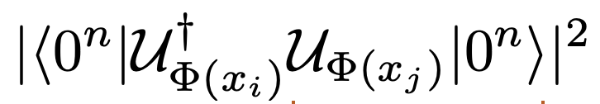
Recap: Classification with quantum kernel estimation

Slide 4
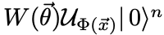
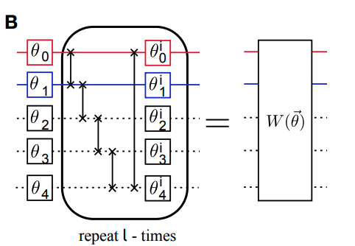
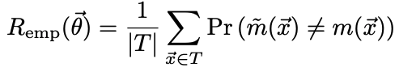
Recap: Parametrized quantum circuit approach
Obtain classification labels directly
out of quantum measurements
Iteratively optimise circuit
parameters with the loss function
Quantum encoding with

Slide 5
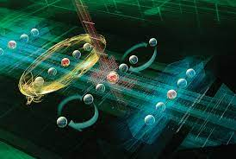
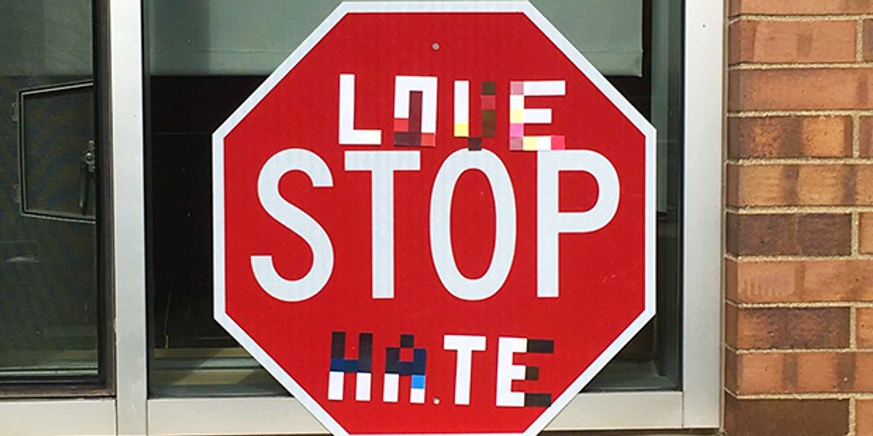
What if classification doesn’t go as planned?
Noise and error in implementation (We don’t have reliable implementation of quantum error correction yet)
Malicious party trying to mislead your algorithm

Slide 6
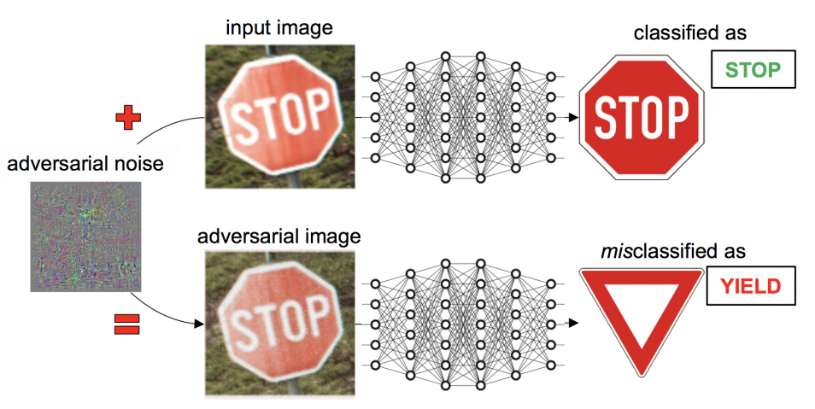
Adversarial Robustness in ML

Slide 7
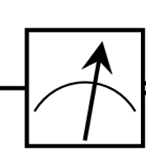
Quantum Circuit Robustness: Setup

Slide 8
Quantum Circuit Robustness: Setup

Slide 9
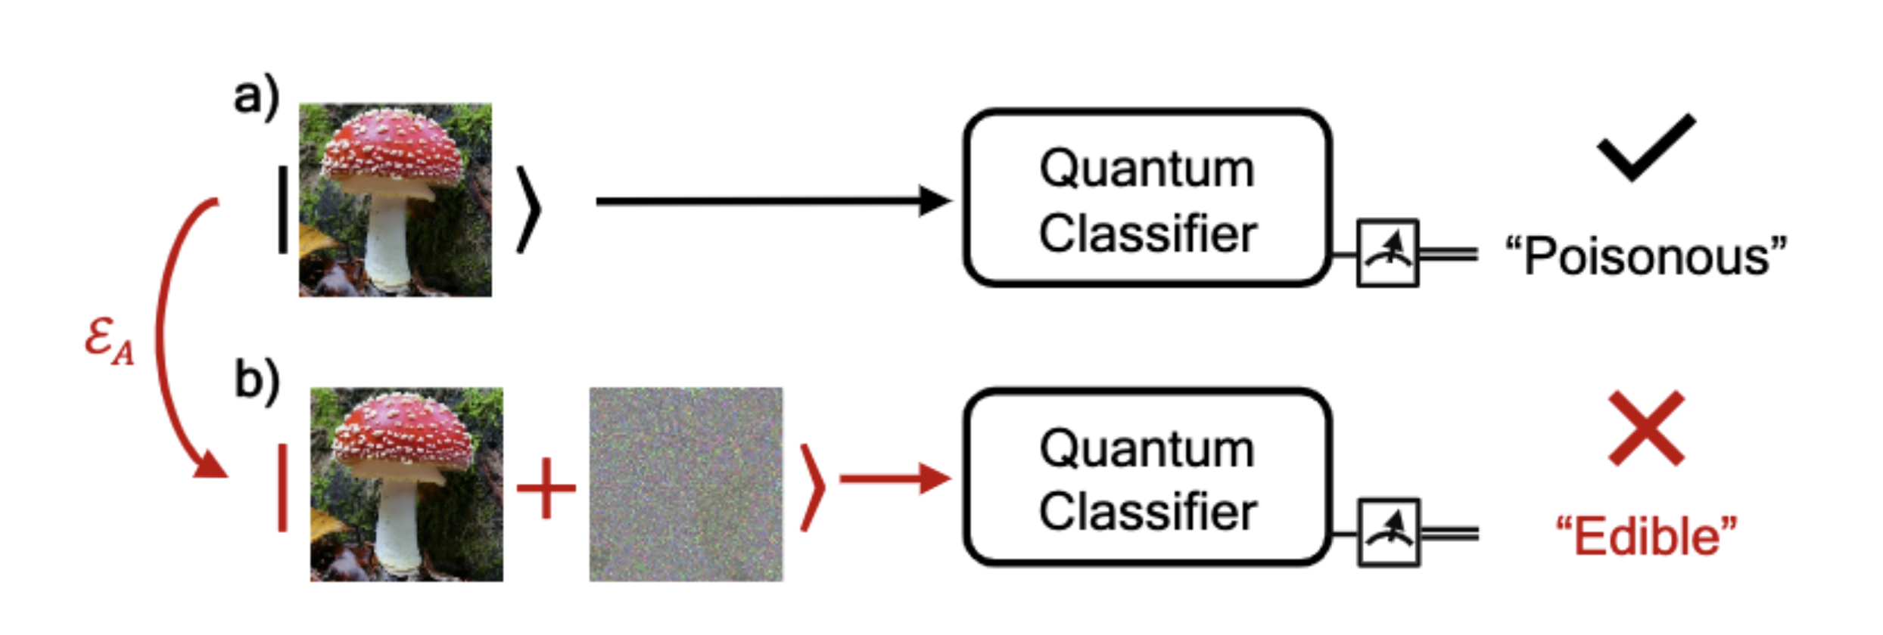
Certifying Quantum Classifiers

Slide 10
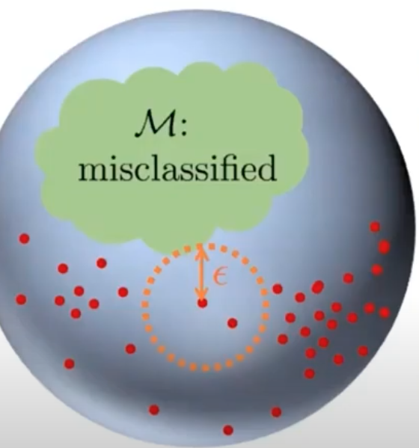
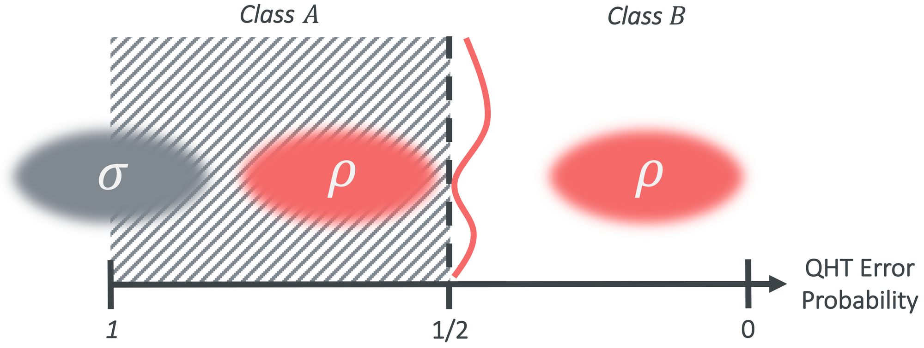
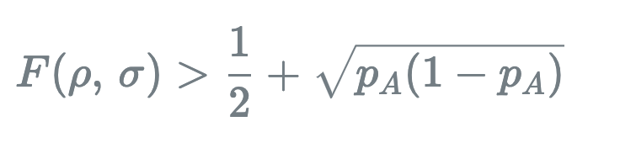
Robustness Guarantee from Quantum Hypothesis Testing
Generic vulnerability:
Phys. Rev. A 101, 062331
Reference: npj Quantum Information volume 7, Article number: 76 (2021)
Blog post: https://ds3lab.ghost.io/quantum-robustness/

Slide 11
Generalized Application: Robustness Certification in the NISQ Era
Error coming from noise of implementation
Imperfection in heuristic methods

Slide 12
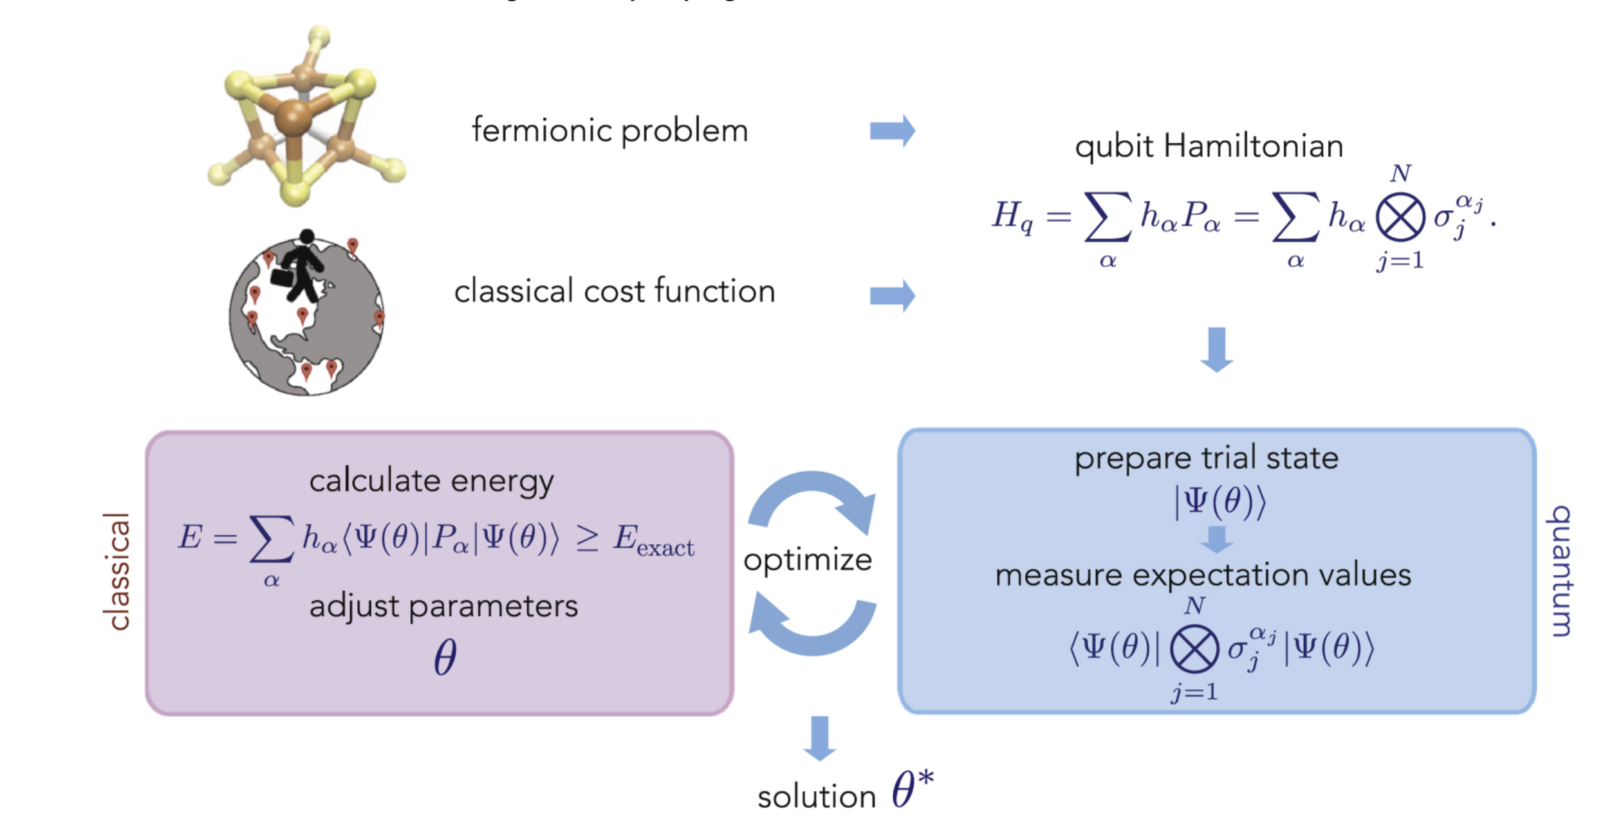
Generalized Application: Robustness Certification in the NISQ Era

Slide 13
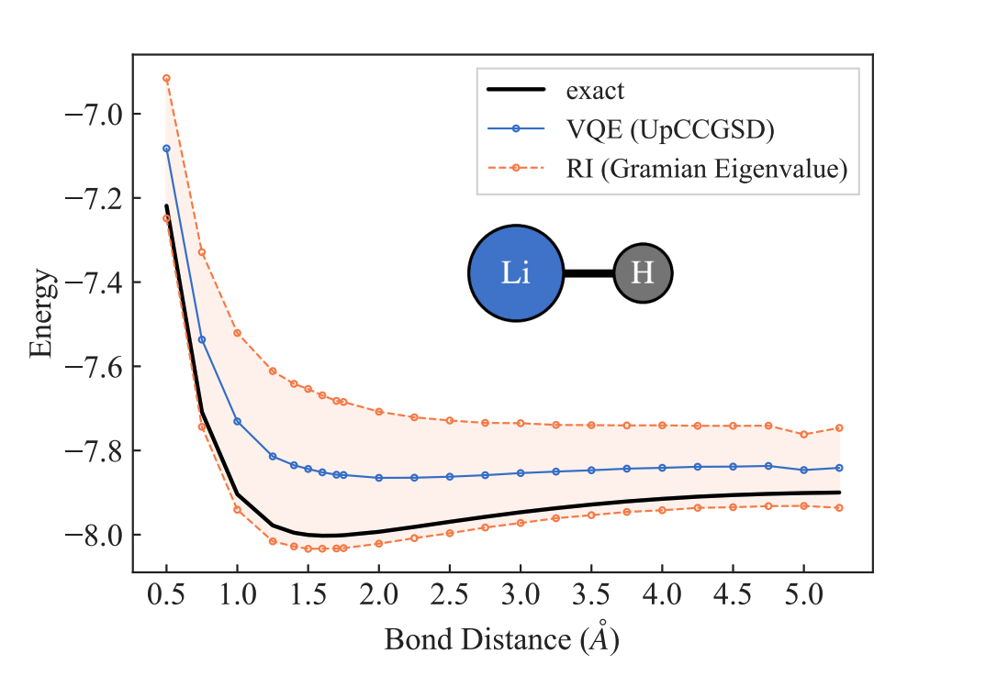
Generalized Application: Robustness Certification in the NISQ Era
Reference: https://arxiv.org/abs/2110.09793

Slide 14

To be continued…
Back to quantum ML algorithms

